Slide 1
Your Rights with School Discipline
Know Your Rights

Slide 2
When can the school discipline me?
Speech?
Clothes?
Protests?
Off-Campus Behavior?
Social Media?
Notes:
Substantial and material disruptions – the school has an interest in limiting these and the courts have decided that they can. The definition for this is a serious physical disturbance of the school day, such as a walkout, a riot, destruction of school property, and other events that make it impossible for school officials to maintain order. This includes disruptions of class as well.
Have students give examples of things that are allowed and that are not allowed.
Speech:
Jokes about violence or school shootings – yes
Unpopular political opinions – no
Opting out of the Pledge of Allegiance – no, but written request from parent or guardian needed.
Sexual jokes – yes
What’s printed in the yearbook – yes
What’s printed in a student-produced, not school-affiliated paper – no, unless substantial and material disruption.
Clothes:
School dress code – yes, if not discriminatory
Political hats – no, unless all hats are prohibited
Hoodies – yes for safety, unless you have a religious or medical reason to wear head coverings.
Protests:
Schools can limit protests if they cause substantial disruption to school activities
Students cannot be punished for just your participation in protests. However, if there is an action that students would be punished for outside of the protests, for example, a walk out. And the school punishes for skipping class, then students can be punished for that action
Schools can make rules about when and where student groups can meet, but they must apply to all student groups
Off-Campus Behavior:
No, unless substantial and material disruption.
Social Media:
No, unless substantial and material disruption, such as bullying or harassment.

Slide 3
Rules & Consequences
Student Code of Conduct
School officials may discipline you for a wide range of actions, including willful disobedience, violence, or any other acts which substantially disrupts the school process.
You may be disciplined for some off-campus conduct. Be careful what you post online.
Behavior at school can have criminal consequences beyond school discipline.
Notes:
Explain all of this can be found in the Student Code of Conduct and where to find it.

Slide 4
Zero Tolerance Policies
Florida requires zero tolerance for bringing weapons to school or making bomb threats
Zero tolerance policies require mandatory expulsion for at least 1 year and to be referred to law enforcement
The School Board can adopt zero tolerance for other actions that pose a threat to school safety
Notes:
Weapons include knife, slingshot, etc.
Both actions can be at school, school function, school activity, or school staff property and still fall under zero tolerance policy

Slide 5
Where Do I Find School Discipline Policies
Student Code of Conduct
Student Handbook
Notes:
Explain to your students, specifically at your school, where to find these policies.

Slide 6
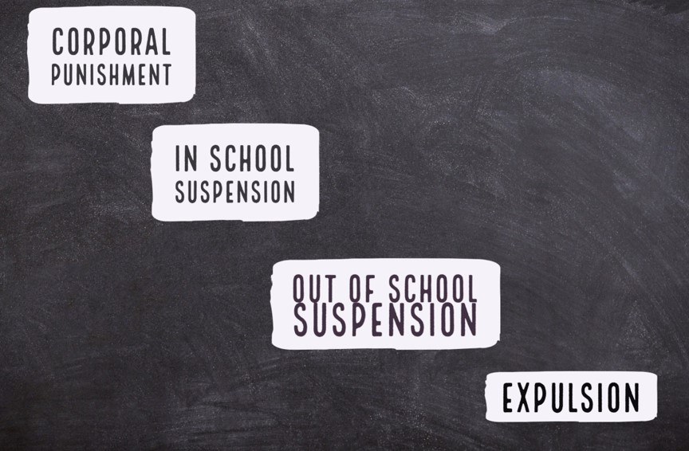
How can the school discipline me?
Notes:
Corporal Punishment: physical force, such as paddling. Cannot be excessive. School district must have a policy allowing it.
In-School Suspension:
The Student can’t go to their usual classes and activities but is placed in an alternative program for up to 10 days.
Out-of-School Suspension: The Student can’t go to any classes or school activities except as authorized by school officials for up to 10 days.
Expulsion: For a period longer than 10 days, the student is prohibited from attending a public school. They may be enrolled in other educational services, such as a disciplinary program or second chance school. Expulsions cannot last more than the remainder of the term or school year and one additional year.
Alternative Placement:
Student is removed from the school for an offense, not expelled, and placed in an alternative educational setting. This is often the functional equivalent to an expulsion (for example the student is reassigned to an alternative school, virtual school or homeschool) in which case it comes with the same due process rights as an expulsion.

Slide 7
Is It School Discipline or Is It a Crime?
Juuls: It is a crime in Florida to give nicotine products to minors. If caught with nicotine products, minors can be punished with community service and a fine.
Drugs: If caught with drugs, including marijuana, you can be arrested.
Fighting: Assault, battery, and disorderly conduct are the most common reasons students are arrested at school.
Sexting: Sending or receiving photos of anyone under 18, including yourself, is a crime in FL. The first offense is treated as a civil offense, with a fine. The third offense becomes a felony.
Notes:
Many students will see that this presentation title and assume “I’m a good kid. This does not apply to me.” It is important for the students to realize that even small “normal teenager stuff” can warrant a school to bring police into the situation. What they may think is a discipline issue at the school, may in fact be a police issue.

Slide 8
Your Rights
You have a right to view your discipline records
You have a right to privacy – the school must have your or your parent’s consent to share your records
You have a right to a fair discipline process
You have a right to notice
You have a right to a hearing
If you are expelled, you have a right to appeal the decision

Slide 9
Due Process
If you are suspended or expelled, you have rights.
The school officials should:
Tell you what you are accused of doing
Tell you what your punishment will be
Give you a chance to tell your side of the story

Slide 10
Students with Disabilities
You have a right to a Manifestation Determination Hearing
Notes:
Students with disabilities are afforded additional protections under state and federal law. This is because the law recognizes that behavior may be a result of disability or the school’s failure to address the student’s needs.
If you have an individualized educational plan (IEP) and are removed from your current education placement, as specified in your IEP, for more than 10 school days, it is considered a change in placement and additional requirements apply, including the right to a manifestation determination hearing.
A manifestation determination hearing is to determine whether the conduct was caused by, or substantially related to, your disability or whether it was the direct result of the school district’s failure to implement your IEP. If the team determines that the behavior met either of these, the district must create or modify the student’s behavioral intervention plan.
If the team determines that the conduct was not a manifestation of disability, the school may discipline you like they would anyone else, except that you must continue to receive educational services even if you are suspended or expelled.
See page 18 of the Handbook.

Slide 11
Protect Your Rights with School Officials
Stay calm
Anything you say can be used against you in a discipline or criminal case.
You can be disciplined for not answering the school official’s questions.
What about SROs?
Notes:
See page 15 of the Handbook.
Students can ask for their parent or an attorney before answering questions, but they do not have a right to one when being questioned by school officials. If students choose not to answer questions, they can be disciplined.
SROs are police officers, and not usually considered school officials, so they should follow the rules for police, which means you would have the right to remain silent.

Slide 12
Summary
You have rights in the school discipline process
The big rights are notice, appeal, and hearings
Students with disabilities have the right to a Manifestation Determination Hearing
Beware of zero tolerance policies
Notes:
The due process rights in the school discipline process are less than those in a criminal case. The process has to be essentially fair.

Slide 13
For more information:
www.aclufl.org
Photo Copyright Flickr-Via Tsuji

Slide 14
WE THE PEOPLE

