Slide 1
Habeas Petitions: Challenging Prolonged & Indefinite Immigration Detention
American Civil Liberties Union
American Immigration Lawyers Association, S FL Chapter

Slide 2
Types of Proceedings
Immigration and Nationality Act (INA), 8 USC § 1001 et al, authority to detain & remove
Regular removal proceedings, INA § 240
Expedited removal proceedings, INA § 235
Administrative removal proceedings, INA § 283b
Withholding-only proceedings after reinstatement of prior removal order

Slide 3
Charging Document
In Regular Removal Proceedings, called “Notice to Appear”
Contains factual allegations and legal charges

Slide 4
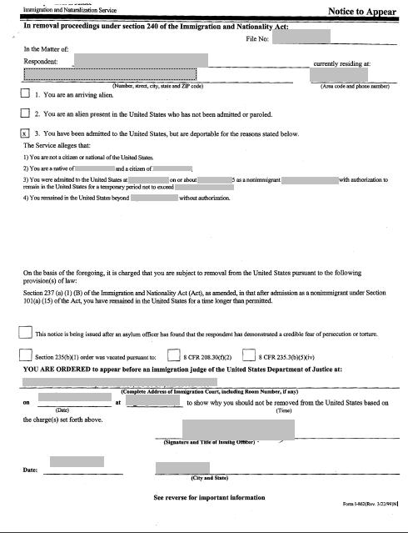

Slide 5
Inadmissibility vs. Deportability
Two types of removal grounds
Grounds of inadmissibility
  INA § 212(a)
Grounds of deportation
  INA § 237(a)

Slide 6
“Arriving Aliens”
Defined at 8 CFR § 1.2
Inadmissible aliens arriving at port of entry or interdicted at sea (can include lawful permanent residents)
Subject to INA § 235 expedited removal
People who cross the border without inspection and are immediately apprehended are also placed in expedited removal proceedings

Slide 7
Typical Scenarios
Lawful permanent resident convicted of a deportable offense (or returning LPR convicted of an inadmissible offense)
Asylum seeker arriving at airport
Asylum seekers arrested in Texas after crossing border
Person who overstayed temporary visa (e.g., tourist)
Person who was paroled into the country

Slide 8
Pre-Order Detention

Slide 9
Detention Statutes
INA § 236(a), general detention statute, contains authority to release on bond or conditional parole
INA § 236(c), “mandatory” detention statute
INA § 235(b), expedited removal detention statute

Slide 10
General Detention Statute, § 236(a)
(a) Arrest, detention, and release. On a warrant issued by the Attorney General, an alien may be arrested and detained pending a decision on whether the alien is to be removed from the United States. Except as provided in subsection (c) of this section and pending such decision, the Attorney General—
(1) may continue to detain the arrested alien; and
(2) may release the alien on—
(A) bond of at least $1,500 with security approved by, and containing conditions prescribed by, the Attorney General; or
(B) conditional parole

Slide 11
Mandatory Detention Statute, § 236(c)
The Attorney General shall take into custody any alien who--
(A) is inadmissible by reason of having committed any offense covered in section 212(a)(2)
(B) is deportable by reason of having committed any offense covered in section 237(a)(2)(A)(ii), (A)(iii), (B), (C), or (D)
(C) is deportable under section 237(a)(2)(A)(i) on the basis of an offense for which the alien has been sentenced to a term of imprisonment of at least one year, or
(D) is inadmissible under section 212(a)(3)(B) or deportable under section ‏237(a)(4)(B)
when the alien is released...

Slide 12
Exception
Mandatory Detention does not apply to individuals who were convicted of an offense and released before October 8, 1998.

Slide 13
Expedited Removal Detention,
INA § 235(b)
(IV) Mandatory detention
Any alien subject to the procedures under this clause shall be detained pending a final determination of credible fear of persecution and, if found not to have such a fear, until removed.

Slide 14
Bond
Can be given by Immigration and Customs Enforcement (ICE) or Immigration Judge
Can ask IJ to re-determine ICE bond decision
Can release on “conditional parole” (release on own recognizance)
Otherwise, minimum bond is $1,500

Slide 15
Bond, continued
File bond request with IJ
Separate proceeding, may or may not be recorded
Standard: Flight risk, Danger to the community

Slide 16
Bond, continued
Judge will consider arrests of convictions of crimes, involvement with drugs, family ties, employment history.
Practical tips

Slide 17
Matter of Joseph hearing
Can request for IJ to determine if mandatory detention applies (INA § 236(c))
Usually when challenging ground of criminal removal
DHS is substantially unlikely to prevail on the charge of removability which is the basis for the mandatory detention.
In re Samuel Joseph, 22 I&N Dec. 799 (BIA 1999)

Slide 18
Board of Immigration Appeals
Has jurisdiction over bond administrative appeals
Separate from appeal of the merits
Question whether need to appeal in order to exhaust administrative remedies before filing habeas

Slide 19
Parole
INA § 212(d)(5)
IJ cannot grant parole
ICE can parole
Discretionary
Standard: significant public benefit, urgent humanitarian reasons
Practical tips

Slide 20
Post-Order Detention

Slide 21
Post-Order Detention
Detention after an administratively final order of removal, INA § 241
  If stay of removal granted then INA § 236 detention
Different than pre-order detention, which is detention while the immigration case is pending
Typically occurs when a person is stateless or the home country refuses to issue travel documents

Slide 22
Post Order Custody Review
90 days after a final order, ICE reviews detention status of person
Supposed to review status every 6 months, ICE Detention Unit in DC
Gives notice
May or may not interview the person

